Slide 1
What is Agile?

Slide 2
Agile
Agile is the most common software development methodology

Slide 3
Software Development Lifecycle
Requirements
Analysis
Design
Coding
Testing
Operations

Slide 4
Waterfall
Stage by Stage
inflexible.

Slide 5
Agile
adapt quickly to changes
Agile Manifesto

Slide 6
Agile Manifesto
Agile Values
Individuals and Interactions over Processes and Tools
Working Software over Comprehensive Documentation
Customer Collaboration over Contract Negotiation
Responding to Change over Following a Plan
Agile Principles
satisfy the customer
Welcome changing requirements
Deliver working software frequently
Business people and developers must work together
Build projects around motivated individuals.
face-to-face conversation
Working software is the primary measure of progress
Agile processes promote sustainable development.
attention to technical excellence and good design enhances agility.
Simplicity
self-organising teams
reflects on how to become more effective

Slide 7
Empirical Process Control
Working in an empirical manner means we work against facts, experience and evidence.
Transparency
Inspection
Adaptation

Slide 8
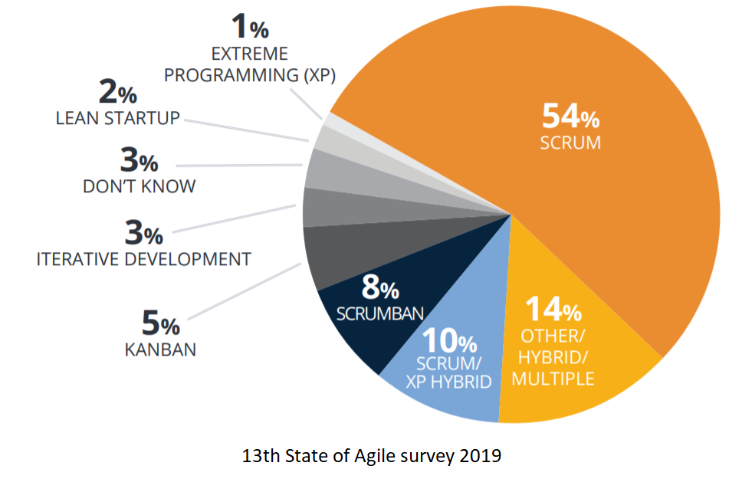
Common Agile development frameworks

